Slide 1
elastic
search

Slide 2

Sponsors

Slide 3
About Me
I live in Durham, North Carolina with a wife + 3 kids (ages 7, 4, 1.5)
Developer for 15+ years in the MSFT stack (C#, VB.NET, MVC, SQL Server, etc.)
Organizer for Raleigh Code Camp
Speaker chair Monthly Triangle .NET Meetup Group
One day I will write a book
Contact Info Twitter: @davidjeet LinkedIn: linkedin.com/in/nosqlguy Blog: EndGameAnalytics.com Github: github.com/davidjeet

Slide 4
Agenda
The “What” & “Why” of Elasticsearch
Quick Start + Search engine basics
Elasticsearch Deep Dive

Slide 5
Agenda
The “What” & “Why” of Elasticsearch
Quick Start + Search engine basics
Elasticsearch Deep Dive

Slide 6

Why Elasticsearch?

Slide 7


Slide 8


Slide 9
Some Considerations
How fast?
Partial Match? E.g. “Apri” matches “April”?
Proximity Search? E.g. “quick fox” matches “The quick brown fox”
Ranking (Scoring)?
Fuzzy Match? E.g. “Chocolite” matches “Chocolate”?
Type-ahead Support?
How well does it scale?

Slide 10
What is Elasticsearch?
NoSQL Database
Full Text Search Engine
REST API
Distributed
Wikipedia: Elasticsearch is a search server based on Lucene. It provides a distributed, multitenant-capable full-text search engine with a RESTful web interface and schema-free JSON documents.

Slide 11
Elasticsearch is…
…a NoSQL full-text search engine based on Lucene.

Slide 12
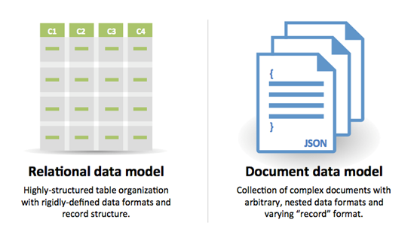
…a NoSQL full-text search engine based on Lucene.
Specifically, it’s a NoSQL Document Database

Slide 13
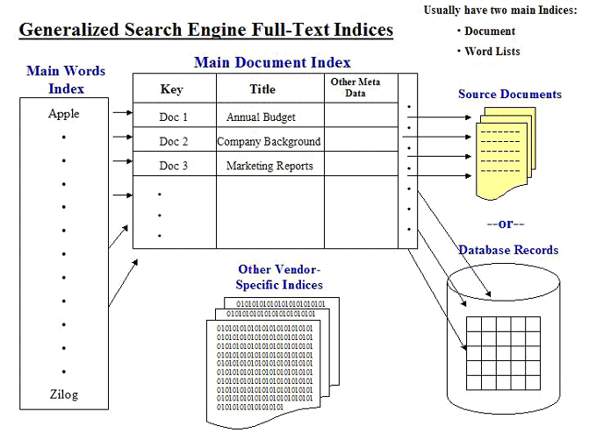
…a NoSQL full-text search engine based on Lucene.
Definition: A search that compares every word in a document, as opposed to searching an abstract or a set of keywords associated with the document using an inverted index.

Slide 14
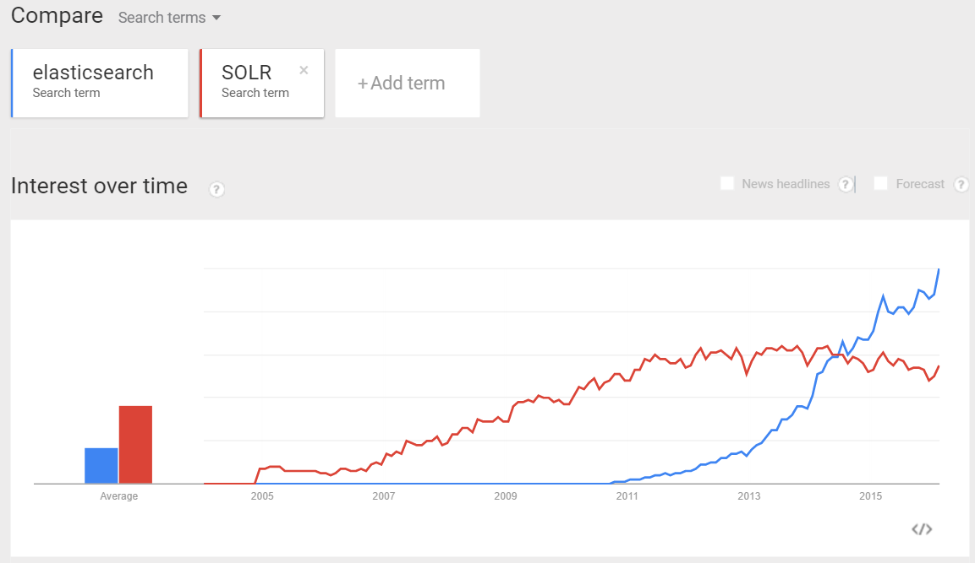


…a NoSQL full-text search engine based on Lucene.
Yonik Seeley
Shay Bannon
https://www.mediawiki.org/wiki/Fulltext_search_engines

Slide 15
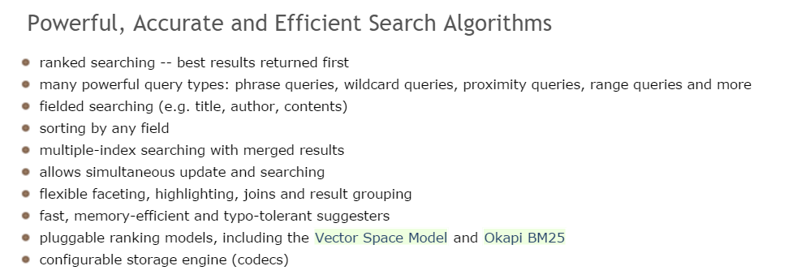
…a NoSQL full-text search engine based on Lucene.

Slide 16
Other Elasticsearch Quick Facts
First public release version v0.4 in February 2010.
Developed in Java, so inherently cross-platform.

Slide 17












Who uses Elasticsearch?

Slide 18
Agenda
The “What” & “Why” of Elasticsearch
Quick Start + Search engine basics
Elasticsearch Deep Dive

Slide 19
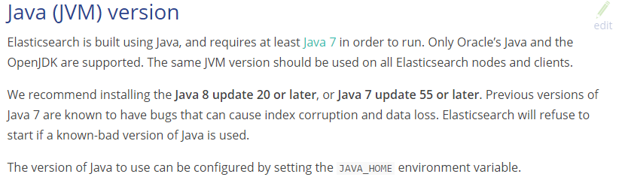
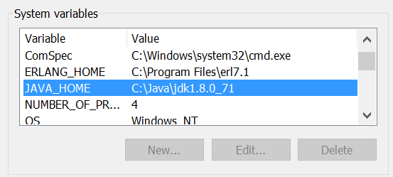
Elasticsearch – Prerequisites for Install

Slide 20
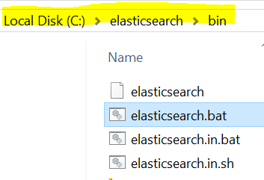
Installation (single node)
Go to https://www.elastic.co/products/elasticsearch
Download and unzip. (e.g. C:\elasticsearch)
Launch elasticsearch.bat

Slide 21
Tools
Curl (command line)
Fiddler (Windows desktop)
Postman (browser)
Marvel/Sense (browser http://localhost:5601/app/sense)

Slide 22
Quick Start, REST (DEMO)

Slide 23
Is It Running?
http://localhost:9200/?pretty
Response :
{
"status" : 200,
"name" : “elasticsearch",
"version" : {
"number" : "1.3.4",
"build_hash" : "f1585f096d3f3985e73456debdc1a0745f512bbc",
"build_timestamp" : "2015-04-21T14:27:12Z",
"build_snapshot" : false,
"lucene_version" : "4.9"
},
"tagline" : "You Know, for Search"
}

Slide 24
Terminology
This Elasticsearch term…
…is like a
Index
Database
Type
Table
Field
Column
Document
Row

Slide 25
Terminology (cont’d)
This Elasticsearch term…
…is like a
Mapping
Schema
Scoring
Ranking
Facet
Aggregation
Aggregation
Aggregation

Slide 26
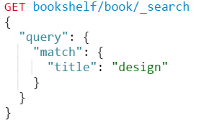
Query DSL
The Query DSL is ElasticSearch's way of making Lucene's query syntax accessible to users, allowing complex queries to be composed using a JSON syntax. For example:

Slide 27
Indexing a document (Create)
POST bookshelf/book/3
{
"title" : "Clean Code",
"author" : "Bob Martin",
"pages" : 464 "tags" : ["programming", "software", "architecture" ]
}
Notes:
explain results

Slide 28
Updating a document
PUT bookshelf/book/3?version=1
{
"title" : "Clean Code",
"author" : "Bob Martin",
"pages" : 464 "tags" : ["programming", "software", "architecture" ]
}
Notes:
explain results

Slide 29
Retrieving a document (Read)
GET bookshelf/book/_search
{
"query": {
"match": {
"title": “programmers"
}
}
}
Notes:
explain results

Slide 30
Deleting a document
DELETE bookshelf/book/2
* Delete by Query will be removed in 2.0: it is problematic since it silently forces a refresh which can quickly cause OutOfMemoryError during concurrent indexing, and can also cause primary and replica to become inconsistent. Instead, use the scroll/scan API to find all matching ids and then issue a bulk request to delete them.
Notes:
explain results

Slide 31
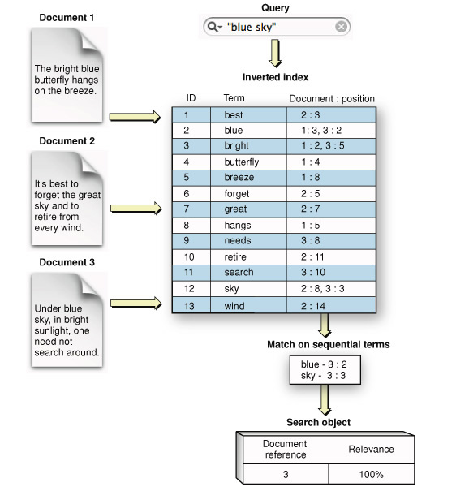
Inverted Indexes

Slide 32
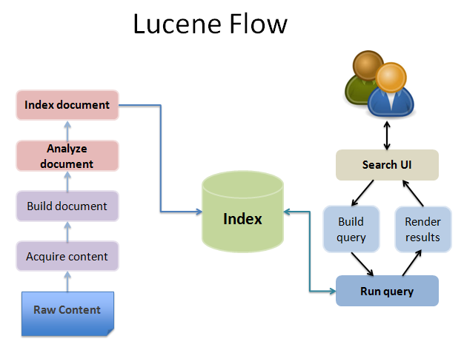

Slide 33
Agenda
The “What” & “Why” of Elasticsearch
Quick Start + Search engine basics
Elasticsearch Deep Dive

Slide 34
Working with .NET (3 ways)
Using C#’s WebRequest or HttpClient
Elasticsearch.NET
Nest

Slide 35
Two drivers: Elasticsearch.NET & Nest
DEMO

Slide 36
MVC Example (StackExchange )
DEMO

Slide 37
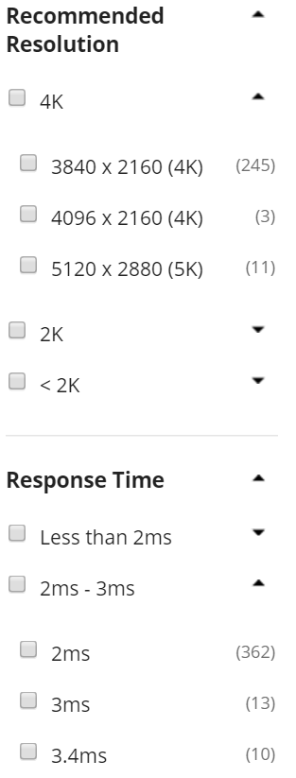
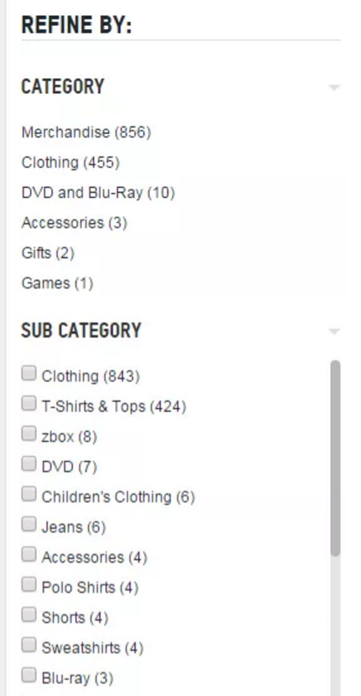
Facets & Aggregations
Example 1
Example 2

Slide 38
Aggregations Example (IMDB )
DEMO

Slide 39
Closing Thoughts & Summary

Slide 40
Real World Considerations
Standalone vs. Part of a System
Elasticsearch PAAS vs. Elasticsearch IAAS

Slide 41
Standalone
Integrated
Web application
Web application
Index new document
Insert new row/ Update row
Search
Elasticsearch
Search for document
SQL DB
Elasticsearch
Sync mechanism
Sync mechanism can be Elasticsearch plugin or your own service

Slide 42
PAAS
IAAS
Web application
Web application
Elasticsearch
Elasticsearch
Node 1
Node 2
Node 3
Nodes & Shards
3
0
2
1
2
1
4
0
3
4
Notes:
The key to understand here is that w/ PAAS your logical and physical layout are the same. For non-PAAS its more complex. But typically you pay a price in terms of $$$ and flexibility with PAAS solutions.

Slide 43
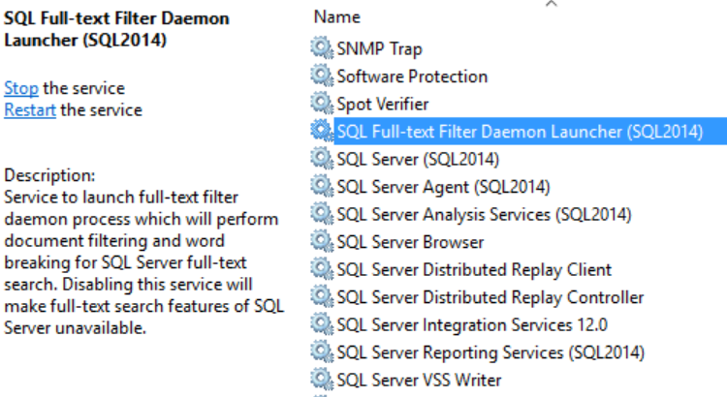
Full-text w/ SQL Server ???

Slide 44
Why not SQL Server?
SQL Server supports full-indexing as well, but there are some limitations/differences:
Full text is only one field per table.
Can only full text search against varchar/text/binary type columns.
Building a Full Text index is extremely I/O intensive (unless starting with little to no data).
It is SQL Server == $$$. Elasticsearch is open source and cost $0 .

Slide 45
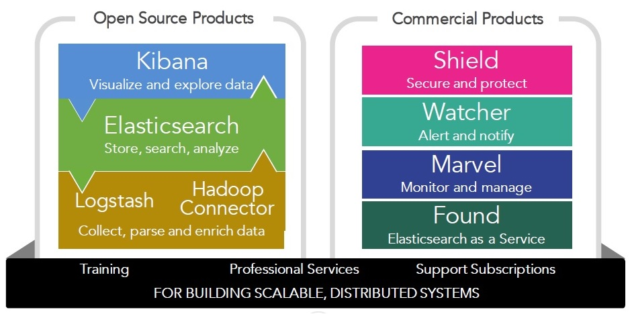
Products
http://www.meetup.com/abctalks

Slide 46
Summary
The “What” & “Why” of Elasticsearch
Quick Start + Search engine basics
Elasticsearch Deep Dive

Slide 47
Thanks for coming!
Twitter: @davidjeet LinkedIn: linkedin.com/in/nosqlguy Blog: EndGameAnalytics.com Github: github.com/davidjeet

